Slide 1
Lecture 21: Ch 7
Punjab University College of Information Technology

Slide 2
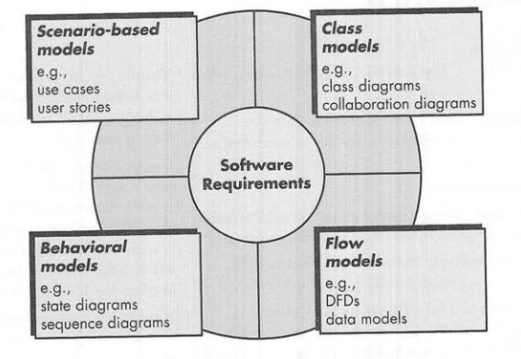
Requirement analysis
Behavioral models that depict how the software behaves as a consequence of external “events”

Slide 3
Sequence Diagram
Type of Behavioral Modeling
Sequence Diagram in UML
How events cause transitions from object to object
State Transition Diagram

Slide 4
Sequence diagrams
sequence diagram: an "interaction diagram" that models a single scenario executing in the system
perhaps 2nd most used UML diagram (behind class diagram)

Slide 5
System Sequence Diagram (SSD)
For a use case scenario, an SSD shows:
The System (as a black box)
The external actors that interact with System
The System events that the actors generate
SSD shows operations of the System in response to events, in temporal order
Develop SSDs for the main success scenario of a selected use case, then frequent and salient alternative scenarios
:System

Slide 6
Key parts of a sequence diag.
participant: an object or entity that acts in the sequence diagram
sequence diagram starts with an unattached "found message" arrow
message: communication between participant objects
the axes in a sequence diagram:
horizontal: which object/participant is acting
vertical: time (down -> forward in time)

Slide 7
Messages between objects
message (method call) indicated by horizontal arrow to other object
write message name and arguments above arrow
dashed arrow back indicates return
different arrowheads for normal / concurrent (asynchronous) methods

Slide 8
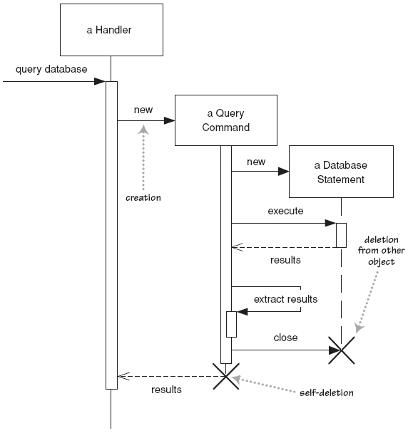
Lifetime of objects
creation: arrow with 'new' written above it
notice that an object created after the start of the scenario appears lower than the others
deletion: an X at bottom of object's lifeline
Java doesn't explicitly delete objects; they fall out of scope and are garbage-collected

Slide 9
From Use Case to Sequence System Diagram
How to construct an SSD from a use case:
Draw System as black box on right side
For each actor that directly operates on the System, draw a stick figure and a lifeline.
For each System events that each actor generates in use case, draw a message.
Optionally, include use case text to left of diagram.

Slide 10
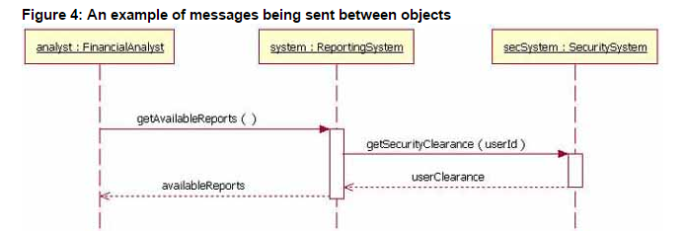
Sequence diag.
Class name: FinancialAnalyst instance: analyst

Slide 11
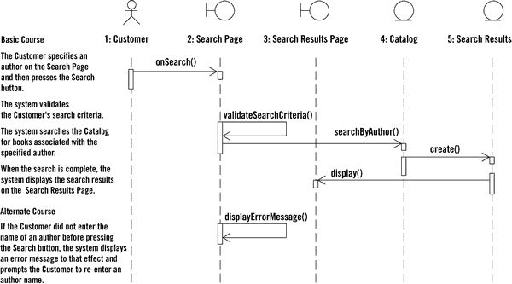
Sequence diag. from use case

Slide 12
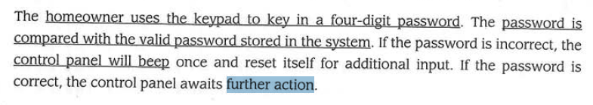

Slide 13
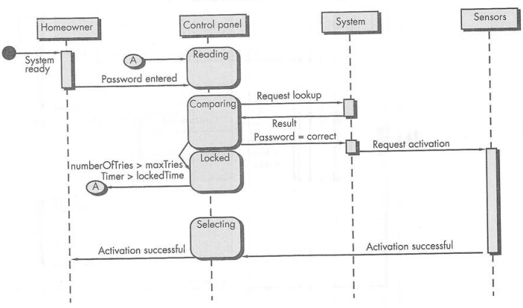

Slide 14
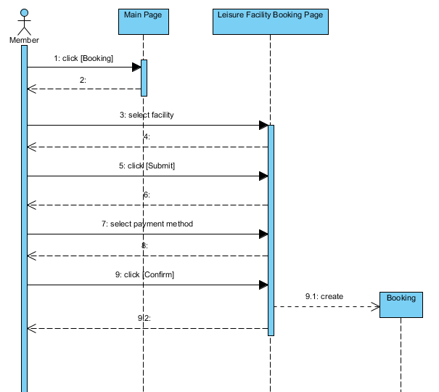

Slide 15
State Transition Diagram

Slide 16
State Transition Diagram
State transition represents what actions are taken as a consequence of a particular event
Represents the behavior of the system by depicting its states and the events that cause the system to change its state

Slide 17
State Transition Diagram
E.g. States of monitoring and control system of vessel
Monitoring state,
Alarm state
Pressure release state and so on

Slide 18
